Slide 1
ABOUT US
Zoom Industrial Services Limited (‘ZISL’ or ‘the Company’) is a public limited company incorporated on 2nd March, 1981 located in Kolkata with the aim & objective of providing best in class niche technical consultancy services. The Corporate Identification Number (‘CIN’) of the company is L74140WB1981PLC033392
The Company provides a wide spectrum of services and ensures value addition at every stage of project development in preparation of pre-feasibility, feasibility and detail project reports in infrastructure sector mainly in drinking & sewage water and Infrastructure.
The experts of the Company have vast experience in complete management of Integrated Water Resource
Management in all types of harsh terrain & geography through sustainable solution. The Company
comprises of a strong taskforce of proficient & dedicated professional managed by qualified Team of
Chartered Engineers under a young & dynamic leadership ensuring the delivery of project within time and
Cost.
Our competencies are based on the strengths and diverse backgrounds of our expert team members.

Slide 2

CONRAD HILTON
“The future belongs to those who believe in the beauty of their dreams”

Slide 3

Zoom Industrial Services Limited
To contribute growth & progress in the field of Water Infrastructures projects, to create a newer, better & meaningful world by becoming preferred choice of customers
MISSION
To be a prime project management consultancy company in the field of water infrastructures & management projects at pan-India level!

Slide 4
ZOOM INDUSTRIAL SERVICES LIMITED
CORE VALUES
Leadership
Commitment
Innovation
Communicating the vision,
establishing mutual agreement, motivating employees,
Committed to Quality and ensures the projects are bid and executed with excellence
Providing innovative resources and cost competitive solution to achieve the goal on time..

Slide 5
Zoom Industrial Services Limited
OUR SERVICES
Project Management
Tendering & Bidding Advisory
Project Management Consultancy
Pre & Post Tender Support including Engineering Support
Environment
Infrastructure Advisory
Sustainable Solution to protect Environment & Its Social impact
Integrated Water Resource Management
Digital Project Monitoring
Financial Services
Implementation of various new edge Digital Monitoring System
Project Financial Management Consultancy

Slide 6
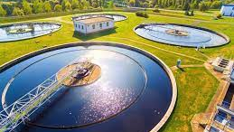
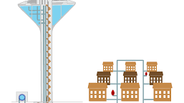
Zoom Industrial Services Limited
WATER SUPPLY
Preparation of Pre-feasibility
Feasibility Report & Detailed Project Reports(DPRs)
Master Planning & Financial Modeling
Detailed field investigations including topographical survey, soil investigation & Hydraulic Modeling.
Preparation of technical specifications
Bid documents for contract packages.
Detailed engineering for civil & Electro-mechanical works for Water Treatment Plant
Project Management Consultancy including construction supervision work and monitoring of progress
Quality assurance and control.

Slide 7
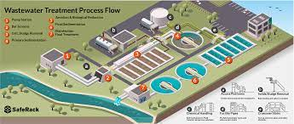
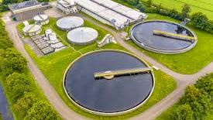
Zoom Industrial Services Limited
SEWAGE
Preparation of Pre-feasibility
Feasibility Report & Detailed Project Reports(DPRs)
Master Planning & Financial Modeling
Detailed field investigations including topographical survey, soil investigation & Hydraulic Modeling.
Preparation of technical specifications with ZLD
Bid documents for contract packages.
Detailed engineering for civil & Electro-mechanical works for Sewage Treatment Plant
Project Management Consultancy including construction supervision work and monitoring of progress
Quality assurance and control.

Slide 8
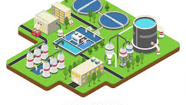
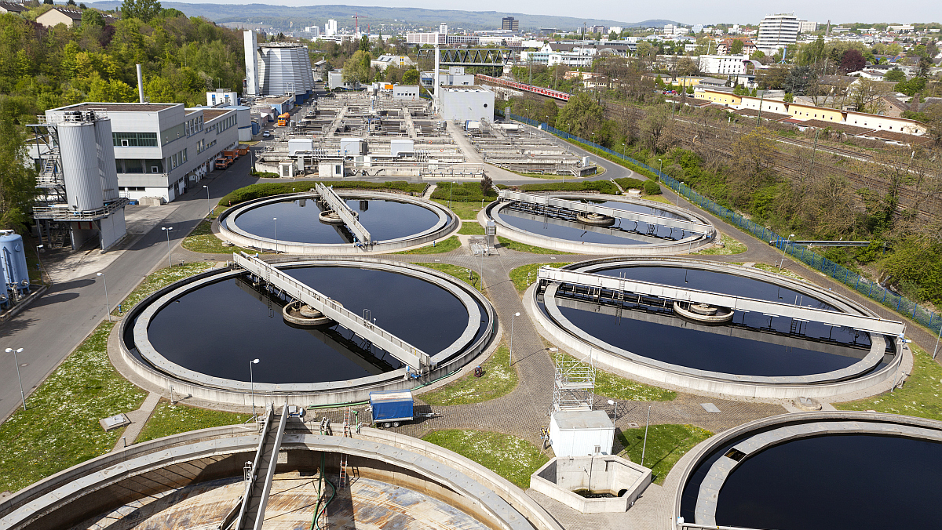
Zoom Industrial Services Limited
WASTE WATER TREATMENT
Process design
Civil, electro-mechanical unit design
Tender stage designs & preparation of technical specifications
Bid documents for contract packages.
Construction stage detailed engineering for civil & Electro-mechanical works
Project Management Consultancy including construction supervision work and monitoring of progress
Rehabilitation plan and DPR preparation
Re-use of treated waste water for industrial and irrigation purpose.
Sludge Handling

Slide 9
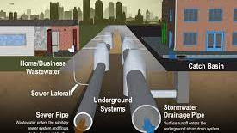
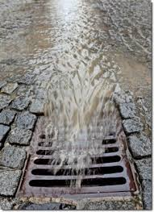
Zoom Industrial Services Limited
STROM WATER DRAINAGE
Flow-monitoring (Open drain and conduit)
Preparation of Pre-feasibility & Feasibility report
Master Planning & Detailed Project Reports(DPRs)
Detailed field investigations including topographical survey and soil investigation and Hydraulic modeling
Preparation of technical specifications.
Bid documents for contract packages.
Construction stage detailed engineering for civil & Electro-mechanical works.
Project Management Consultancy including construction supervision work and monitoring of progress

Slide 10
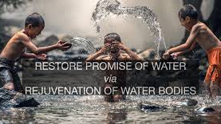
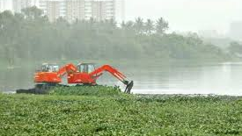
Zoom Industrial Services Limited
WATER BODIES REJUVENATION
Lake/River/Nallah restoration and its sustainable maintenance
Maintenance and monitoring
Interception and Diversion Design
Revival of local ecosystems
Beautification of lake

Slide 11


Zoom Industrial Services Limited
FINANCIAL SERVICES
Loan Mobilization
Restructuring
M&A
Fund raising through various instruments
IBC
Investment planning
Any other finance related activities

Slide 12

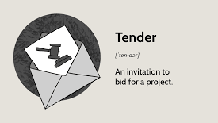
Zoom Industrial Services Limited
PRE TENDERING SERVICES
We provide Pre tendering services with value added service which is auditable, accountable and transparent.
Prepare and do the realistic Estimates based on: quality design and costing through detailed structure wise cost breakdown.
Utilize the cost plan to demonstrate the project budget.
Proper documentation and Proposal preparation as per the Government guidelines.

Slide 13
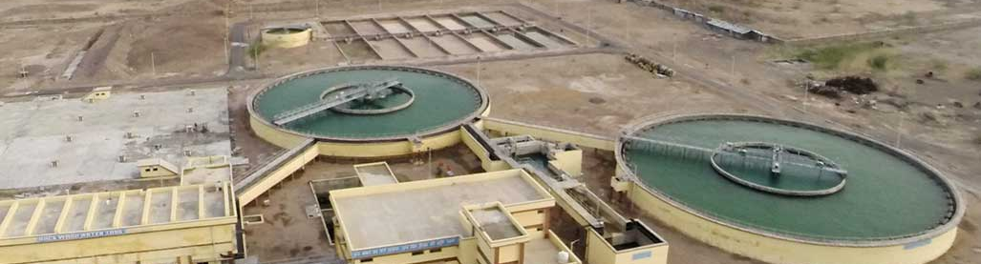
GET IN TOUCH WITH US
113 Park Street, Poddar Point, 7th Floor, Kolkata, West Bengal- 700016.
ZOOM INDUSTRIAL SERVICES LIMITED

